Slide 1

PARTNER INFO
SuperOffice Norway
10.01.2022 Oslo

Slide 2
Agenda
New Migration Services
Product update
Q & A

Slide 3

SuperOffice Cloud
New Migration Services
Notes:
THE PURPOSE OF THIS GUIDE IS TO INFORM EMPLOYEES & PARTNERS ABOUT THE EXTENDED MIGRATION SERVICES WE OFFER OUR CUSTOMERS

Slide 4

Why new migration services?
So far, we've successfully migrated 1,215 customers to SuperOffice CRM Cloud. To help the customers make this move, we took care of the migration without additional costs.
However, going forward we’ll be working with larger customers who have more complex solutions.
This asks for a different approach. We can't tell them that the migration can be completed within a day like we've been able to do before.
To make it possible to migrate all the remaining customers to SuperOffice Cloud, we've developed a new set of paid services that will guarantee a successful migration regardless of their CRM solution.
We call these services the extended migration services (EMS).
Notes:
Motivations for EMS

Slide 5
What's included in EMS?
R&D communication channel
Migration stand-by team
Test environment
An appointed Migration Resource manager
Specialized support personnel
A stand-by team to support both the test & live-migration
WebEx Group
A free test environment, monitoring reports and a migration evaluation
Notes:
What's included in EMS
R&D resources and response team stand-by during test-migration, workhours (need to be pre-booked) WebEx Group
R&D Resources and response team stand-by during live migration, workdays and weekends (need to be pre-booked)
Monitoring and Reporting: Power BI reports "Migration dashboard" (both for test env. and for live env.)
Extra hardware during the monitoring phase: A 'protected' environment (both for test env. and for live env.)
Extra hardware during the test phase

Slide 6

When do we use EMS?
When a customer is interested in migrating their database to SuperOffice CRM Cloud, you must review the customer's situation together with your Pre-sales or consultancy manager.
Together, you'll conclude whether this customer needs a normal migration or the extended migration services. ​
​
When a customer has many users, multiple third-party apps (standard or custom), complex customizations or require test migration they must use EMS
It's important to remember that not every customer situation will need extended migration services. ​
Notes:
Motivations for EMS

Slide 7

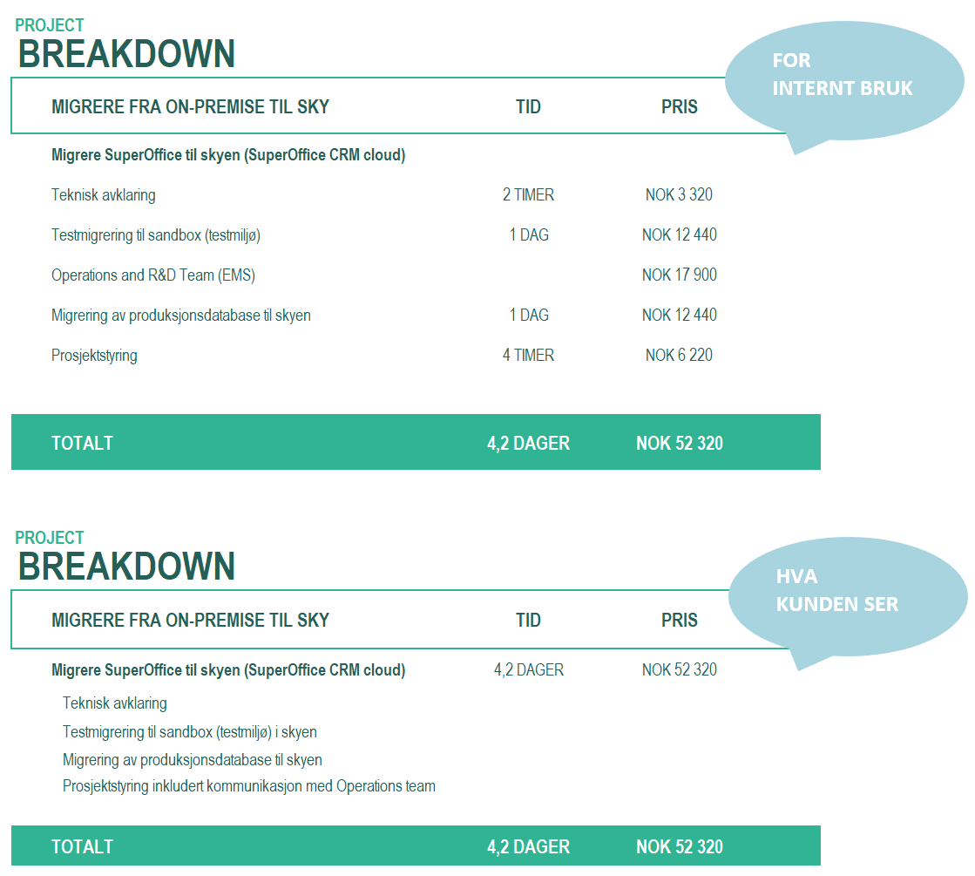
Prices for new migration services
NOK 20 000
Notes:
Motivations for EMS

Slide 8













The EMS migration lifecycle
Production
Cloud Env.
Sandbox (test)
Cloud Env.
Production
Cloud Env.
Clone the Online env.
Disable the customer task.
Invalidate email address
Stop schedule task
Clone the Online env.
Disable the customer task.
Invalidate email address
Stop schedule task
Run OMT on Test
Run the migration tool to migrate the customers test database in our Cloud solution
Run OMT in Production
Run the actual migration tool on the production database to migrate the customer database into our Cloud solution
When ready!
Clone the Onsite env.
Copy the production database and change serial number in the testdatabase
Production
Onsite/Buy Env.
Test
Onsite/Buy Env.

Slide 9

Failing to follow EMS can lead to:
You will have migrated the customer – and the customer may not be able to log-in to their production database onsite
Setup of custom app will be impossible when a new migration is forced and overwrites the production database they have been using as test
The current 3rd party standard apps may stop working in production (and test), and we must involve the partner to clean up as they will store a secure token on their side (encrypted)
The Test Tenant will not be placed in the appropriate clusters – safeguarding the production environment
IN SHORT – A WHOLE LOT OF MESS A LOT OF PEOPLE NEED TO CLEAN UP
Notes:
Motivations for EMS

Slide 10
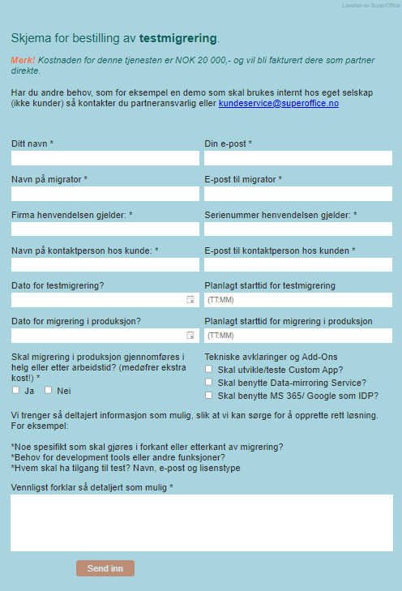
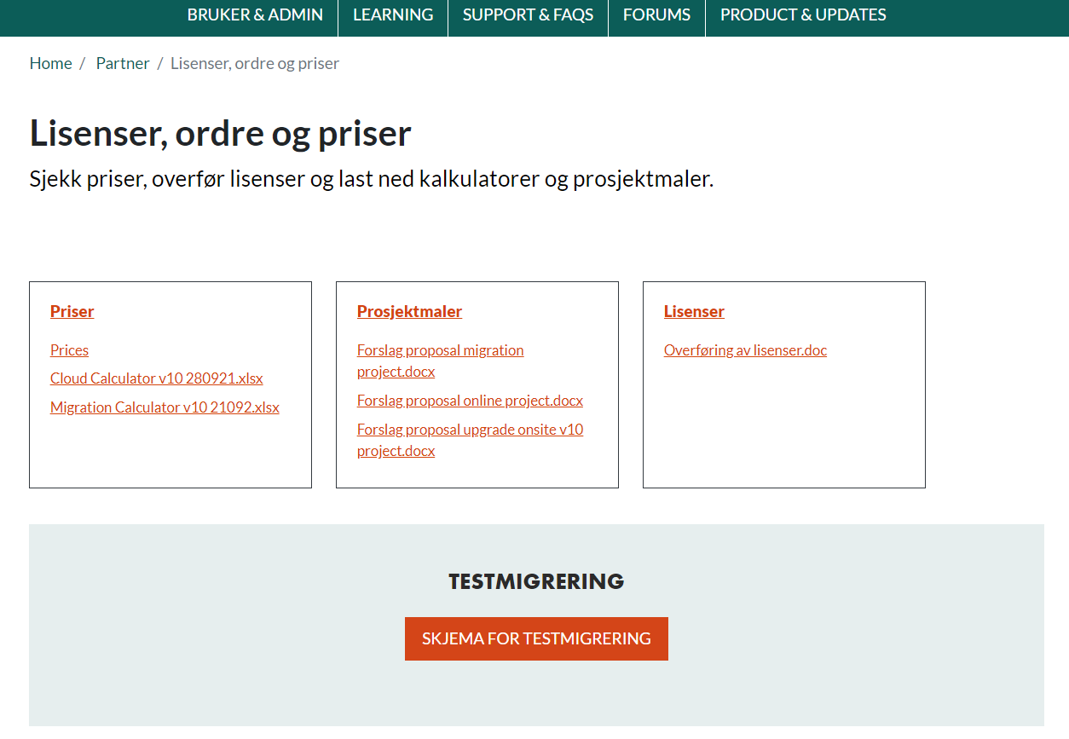
How to order EMS?

Slide 11

ROADMAP
Ongoing projects

Slide 12



SALESBUDGET
MOBILE CRM
NEW SERVICE
Get focus, motivation and prioritize the right actions with sales goals
Support business logic in the Mobile client
New interface available from the CRM client. Merge all functions into one client

Slide 13
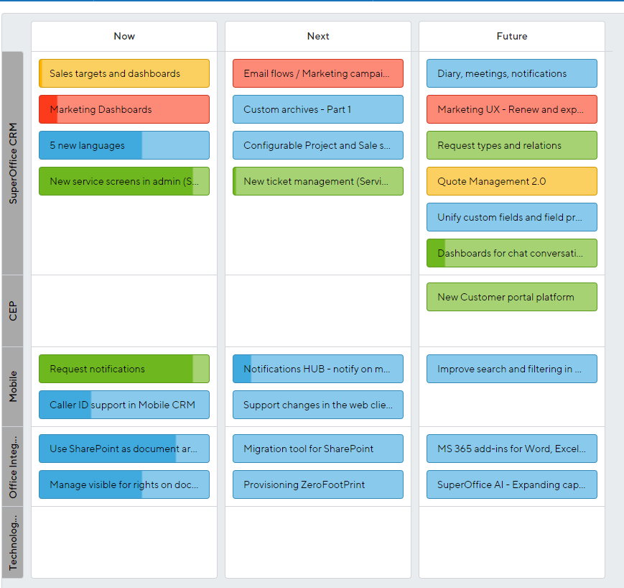

Slide 14
Q&A

